Slide 1

CRICKET TOURNMENT
MANAGEMENT SYSTEM
PROJECT PRESENTATION
SOFTWARE ENGINEERING
04/11/2023
1

Slide 2
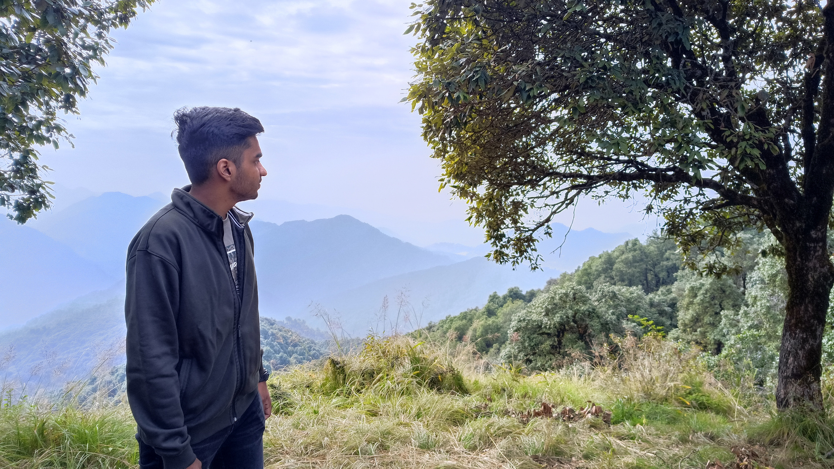
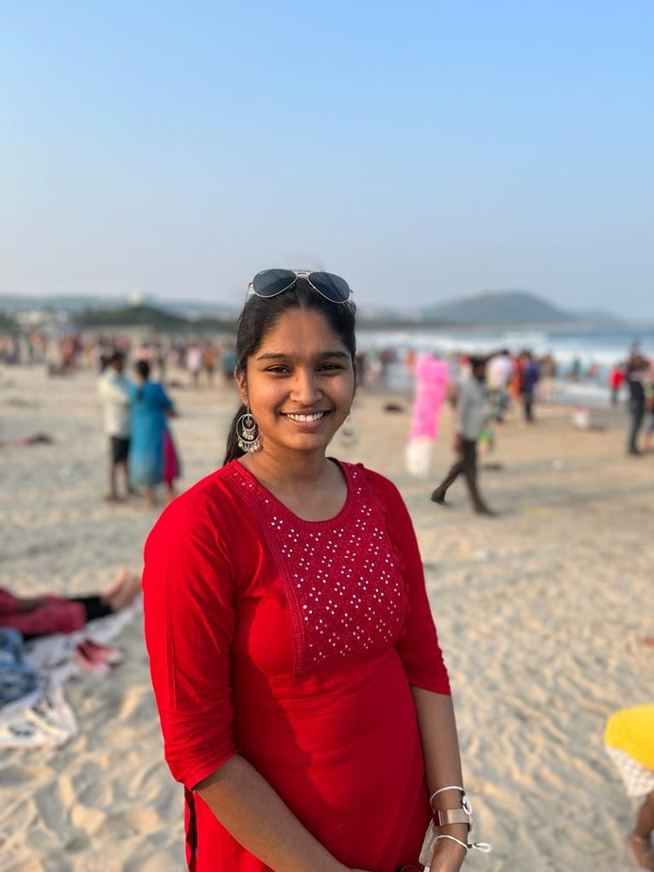
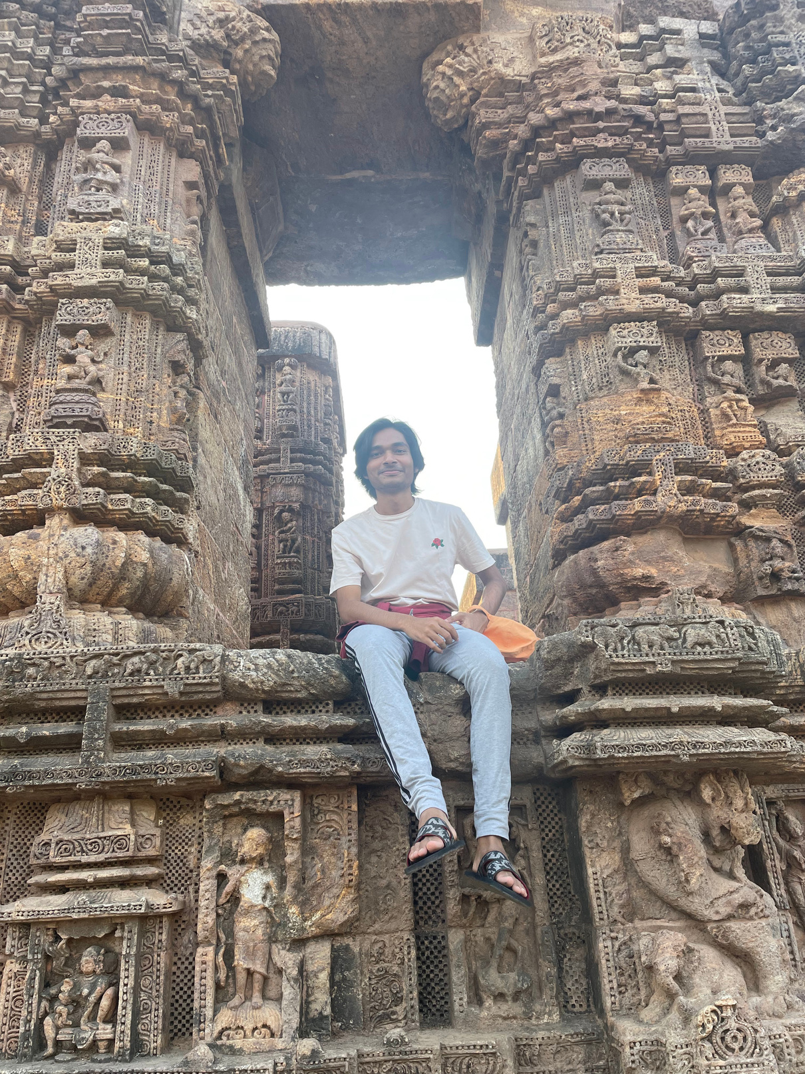
OUR TEAM
ANIT
THOYAJAKSHI
RATAN
2

Slide 3
TOPIC OVERVIEW
This project is the building of a cricket management system software. This software would store and manage information related to a cricket tournament such as the teams, players, match details and statistics. The software will store lot of information like team details, match details, player details, and tournament statistics(with specific test cases).To make the system development easier, database is used rather than taking all details as input, which would make it a bit more complex. Hence except the number of teams , all other particulars are randomly generated from the database.
3

Slide 4
MOTIVATION
Managing a cricket team or league can be a complex task that requires coordination, organization, and attention to detail. Many cricket organizations have turned to technology solutions, that is where our cricket management system software comes in, which decreases the burden on administrative managers. This helps with improved efficiency, increased accuracy and better communication between different stake holders of the tournament. And we were curious about dealing with database management systems and SQL.
4

Slide 5

IDEATION
BACKEND
The first step was to decide on the use cases that are to be served according to the requirements of the project and selecting a suitable language.
For backend we choose to go with Python for its versatility and ease, and a terminal-based interface was developed accounting for all the use-cases.
METHOD
FRONTEND
DOCUMENTATION
In parallel, a GUI was developed using the Cross-Platform Kivy framework and then integrated with the the backend.
Along with the backend and frontend, the required documents like SRS document, use-case diagram, test plan and test suite are made
5

Slide 6

CHALLENGES
CHALLENGE 1
Learning the nuances of SQLite.
CHALLENGE 2
Figuring out a round-robin system algorithm.
CHALLENGE 3
Had to figure out how to randomly distribute runs, bowls and wickets among players of the 2 teams in match given the overall outcome, making sure no constraint of cricket is violated.
6

Slide 7
CHALLENGES
CHALLENGE 4
Choosing Kivy, lead to issues in implementing certain functionalities like pop-ups and data tables, it was not very convenient with Kivy. We had to use KivyMD's material design compliant widgets in place.
7

Slide 8
WORK DISTRIBUTION
ANIT :
BACKEND, IDEATION
RATAN :
FRONTEND, IDEATION
THOYAJAKSHI :
DOCUMENATATION, IDEATION
8

Slide 9
THANK YOU!!!
9

